Slide 1
Design Patterns
Unit 01
Introduction to Design Patterns
西安电子科技大学软件工程研究所
李雁妮
Email: yannili@mail.xidian.edu.cn

Slide 2
前提条件
  面向对象程序设计语言
  面向对象的基本概念
  请回答问题：
    面向对象的3个基本特点是什么？
      什么是继承？
      什么是封装？
      什么是多态？
    类和对象的关系？

Slide 3
What Is A Pattern?
  Current use comes from the work of the architect Christopher Alexander
  Alexander studied ways to improve the process of designing buildings and urban areas
  “Each pattern is a three-part rule, which expresses a relation between a certain context, a problem and a solution.”
  Hence, the common definition of a pattern: “A solution to a problem in a context.”
  Patterns can be applied to many different areas of human endeavor, including software development

Slide 4
Why Patterns?
  Designing object-oriented software is hard and designing reusable object-oriented software is even harder."
  - Erich Gamma
  Experienced designers reuse solutions that have worked in the past
  Well-structured object-oriented systems have recurring patterns of classes and objects
  Knowledge of the patterns that have worked in the past allows a designer to be more productive and the resulting designs to be more flexible and reusable

Slide 5
Software Patterns History
  1987 -- Cunningham and Beck used Alexander’s ideas to develop a small pattern language for Smalltalk
  1990 -- The Gang of Four (Gamma, Helm, Johnson and Vlissides) begin work compiling a catalog of design patterns
  1991 -- Bruce Anderson gives first Patterns Workshop at OOPSLA (Object-Oriented Programming, Systems, Languages & Applications)
  1993 -- Kent Beck and Grady Booch sponsor the first meeting of what is now known as the Hillside Group
  1994 -- First Pattern Languages of Programs (PLoP) conference
  1995 -- The Gang of Four (GoF) publish the Design Patterns book

Slide 6
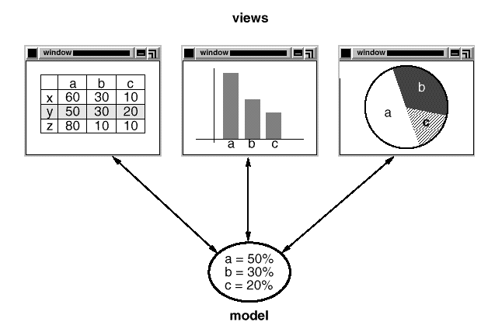
Smalltalk MVC
Observer
Composite
Strategy
Factory Method
Decorator

Slide 7
Types of Software Patterns
  Analysis
  Design
  Organizational Process
  Project Planning
  Configuration Management

Slide 8
Types of Software Patterns
  Riehle and Zullighoven in “Understanding and Using Patterns in Software Development” mention three types of software patterns
  Conceptual Pattern (Software Architecture)
    Pattern whose form is described by means of terms and concepts from the application domain
  Design Pattern
    Pattern whose form is described by means of software design constructs, such as objects, classes, inheritance and aggregation
  Programming Pattern (Programming Idiom)
    Pattern whose form is described by means of programming language constructs

Slide 9
Design Pattern Levels of Abstraction
  Complex design for an entire application or subsystem
  Solution to a general design problem in a particular context
  Simple reusable design class such as a linked list, hash table, etc.
  More Abstract
  More Concrete

Slide 10
GoF Design Patterns
  The GoF design patterns are in the middle of these levels of abstraction
  “A design pattern names, abstracts, and identifies key aspects of a common design structure that makes it useful for creating a reusable object-oriented design.”
  The GoF design patterns are “descriptions of communicating objects and classes that are customized to solve a general design problem in a particular context.”

Slide 11
GoF Classification of Design Patterns
  Purpose - what a pattern does
    Creational Patterns
      Concern the process of object creation
    Structural Patterns
      Deal with the composition of classes and objects
    Behavioral Patterns
      Deal with the interaction of classes and objects
  Scope - what the pattern applies to
    Class Patterns
      Focus on the relationships between classes and their subclasses
      Involve inheritance reuse
    Object Patterns
      Focus on the relationships between objects
      Involve composition reuse

Slide 12
GoF Essential Elements of Design Patterns
  Pattern Name
    Having a concise, meaningful name for a pattern improves communication among developers
  Problem
    What is the problem and context where we would use this pattern?
    What are the conditions that must be met before this pattern should be used?
  Solution
    A description of the elements that make up the design pattern
    Emphasizes their relationships, responsibilities and collaborations
    Not a concrete design or implementation; rather an abstract description
  Consequences
    The pros and cons of using the pattern
    Includes impacts on reusability, portability, extensibility

Slide 13
GoF Design Patterns(Continued)
范围 | 创建型 | 结构型 | 行为型
类 | Factory Method | Adapter_Class | Interpreter Template Method
对象 | Abstract Factory Builder Prototype Singleton | Adapter_Object Bridge Composite Decorator Facade Flyweight Proxy | Chain of Responsibility Command Iterator Mediator Memento Observer State Strategy Visitor

Slide 14
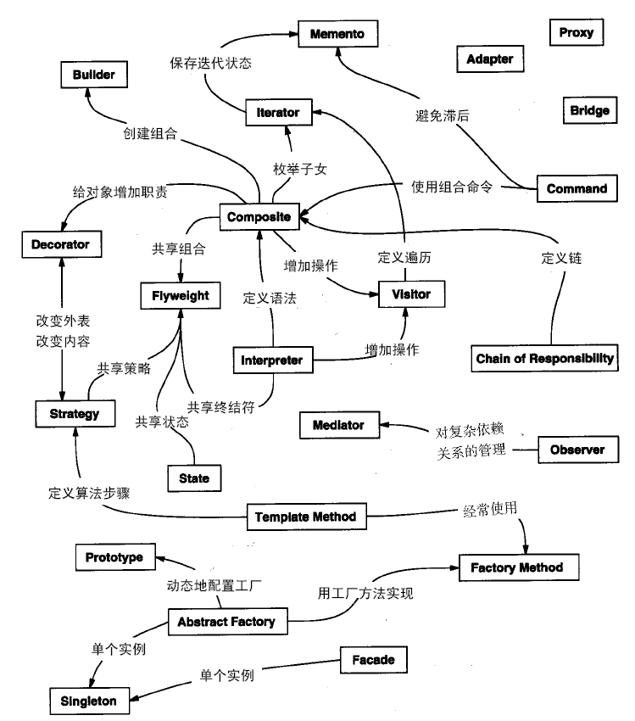

Slide 15
GoF Pattern Template
  Pattern Name and Classification
    A good , concise name for the pattern and the pattern's type
  Intent
    Short statement about what the pattern does
  Also Known As
    Other names for the pattern
  Motivation
    A scenario that illustrates where the pattern would be useful
  Applicability
    Situations where the pattern can be used

Slide 16
GoF Pattern Template (Continued)
  Structure
    A graphical representation of the pattern
  Participants
    The classes and objects participating in the pattern
  Collaborations
    How to do the participants interact to carry out their responsibilities?
  Consequences
    What are the pros and cons of using the pattern?
  Implementation
    Hints and techniques for implementing the pattern

Slide 17
GoF Pattern Template (Continued)
  Sample Code
    Code fragments for a sample implementation
  Known Uses
    Examples of the pattern in real systems
  Related Patterns
    Other patterns that are closely related to the pattern

Slide 18
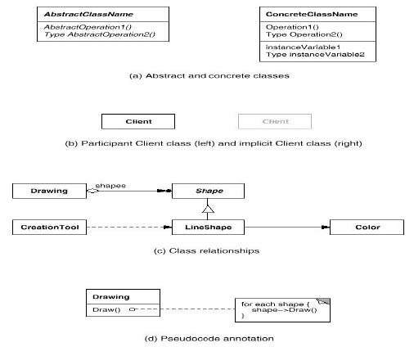
GoF Notation
  The GoF book uses the Object Modeling Technique (OMT) notation for class and object diagrams:

Slide 19
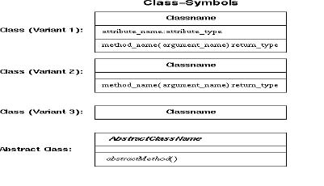
UML Notation
  We will also use the Unified Modeling Language (UML)

Slide 20
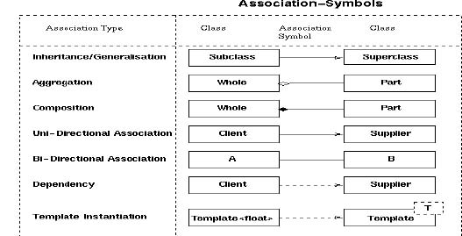
UML Notation (Continued)

Slide 21
Benefits of Design Patterns
  Capture expertise and make it accessible to non-experts in a standard form
  Facilitate communication among developers by providing a common language
  Make it easier to reuse successful designs and avoid alternatives that diminish reusability
  Facilitate design modifications
  Improve design documentation
  Improve design understandability

Slide 22
Teaching Material & Reference
  Erich Gamma, Richard Helm, Ralph Johnson and John Vlissides. Design Patterns Object-Oriented Software. China Machine Press.
  耿祥义、张跃平. 《JAVA设计模式》，清华大学出版社，2009.

Slide 23
Design Patterns Books
  Design Patterns: Elements of Reusable Object-Oriented Software, Gamma, Helm, Johnson and Vlissides, Addison-Wesley, 1995 Design Patterns for Object-Oriented Software Development,
  Wolfgang Pree, Addison Wesley/ACM Press, 1995 Patterns of Software: Tales From The Software Community,
  Richard P. Gabriel, Oxford University Press, 1996 Pattern Oriented Software Architecture : A System of Patterns,
  Frank Buschmann (Editor), Wiley, 1996 Analysis Patterns: Reusable Object Models, Martin Fowler,
  Addison-Wesley, 1997 AntiPatterns, Brown, Malveau, McCormick and Mowbray,Wiley, 1998

Slide 24
Design Patterns Books
  Pattern Hatching: Design Patterns Applied, John Vlissides, Addison-Wesley, 1998
  Patterns in Java Volume 1, Mark Grand, Wiley, 2nd Ed., 2002
  Patterns in Java Volume 2, Mark Grand, Wiley, 1999
  Java Enterprise Design Patterns: Patterns in Java Volume 3, Mark Grand, Wiley, 2001
  Java Enterprise Design Patterns - Patterns in Java: Volume 3, Mark Grand, Wiley, 2001
  The Patterns Handbook, edited by Linda Rising, Cambridge University Press, 1998
  Java Design Patterns - A Tutorial, James W. Cooper, Addison-Wesley, 2000

Slide 25
Design Patterns Books
  Design Patterns Explained, Alan Shalloway and James R. Trott,Addison-Wesley, 2001
  Design Patterns Java Workbook, Steven John Metsker, Addison-Wesley, 2002
  Applied Java Patterns, Stephen Stelting and Olav Maassen,Prentice Hall, 2002
  Core J2EE Patterns: Best Practices and Design Strategies, Alur,Crupi and Malks, 2001
  EJB Design Patterns: Advanced Patterns, Processes, and Idioms, Floyd Marinescu, John Wiley, 2002

Slide 26
Design Patterns Books
  Java与模式, 阎宏，电子工业出版社，2004

Slide 27
EXAMINATION
  出勤 10%
  考试 60%
  平时作业+1个项目 20%+10%
平时作业：每个5个模式的讲解文档+各自的示例程序(程序设计语言不限)
考试前提交项目相应文档（需求说明书、概要设计，详细设计，配置文档）及可运行的源代码，每个项目由2~3名学生组成。
项目考核重点：所用到的设计模式（3个或以上），编码规范（变量命名规范、注释规范等），功能完整，操作简单。

Slide 28
PROJECT
大作业可选择以下三种类别之一：
  教师指定项目
  文档编辑器（书中第二章项目）
  经教师审查后的自由命题项目

